Slide 1
Balancing Security and Convenience
Notes:
Today we would like to speak with you about something we call security beyond the fortress

Slide 2
Security
Convenience
Notes:
of white collar employees use more than one wireless device for work and private purposes

Slide 3
Security
Convenience
Notes:
of white collar employees use more than one wireless device for work and private purposes

Slide 4
Security:
The state of being free from danger or threat.
Procedures or measures used to protect electronic data from unauthorized access or use.

Slide 5
Control

Slide 6
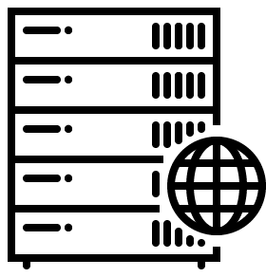
This Is The Fortress
Cloud Based
IAM
Extranet
CASB
I/PaaS
Regional Office 1
Firewall
Virtual
Firewall
Threat Intel.
Virtual WAF
Internal Network
Demilitarized Zone (DMZ)
Access Policy
Manager
Remote
Access
Gateway
Trusted SaaS
Solutions
Consolidated Firewall
( Incl. IDS/IPS, Sandbox, Filtering, Etc.)
Endpoint
East-West
Firewall
Internet
CASB
Untrusted SaaS
Solutions
Analytics/Siem
Mobile
Device
Management
PAM
Data Center
Regional Office 1
Remote Users - Mobile and Desktop

Slide 7
The fortress secures your core services
(Firewalls, Container, VPN, Exfiltration, CASB, IPS etc.)
Notes:
So, let’s start by asking: what is the Fortress?
The Fortress secures your core services.
It includes the security layers that most everyone is familiar with: firewalls, containers, VPN, exfiltration tools, intrusion protection, and cloud access security broker services

Slide 8
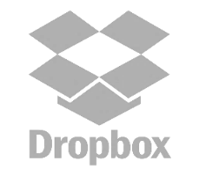
Convenience: I want to use my device with my apps connecting from anywhere to any service Immediately in order to be more productive
Notes:
They want to use their devices, with their apps, connecting from anywhere, using any service.
In any way that makes them productive.
It’s not that they want to violate policy; it’s just because they simply want to get their work done.

Slide 9
Technology
+
User expectations

Slide 10
I want to use my device
with my apps connecting from anywhere to any service
Immediately
In order to be more productive
This is what your fortress is designed to protect
This is what happens beyond the fortress
Notes:
They want to use their devices, with their apps, connecting from anywhere, using any service.
In any way that makes them productive.
It’s not that they want to violate policy; it’s just because they simply want to get their work done.

Slide 11
More Than
600
Services In Use
In THE FORTRESS
Services In Use
OUTSIDE OF THE FORTRESS
Notes:
While the Fortress is designed to protect a few core services inside, hundreds of services are being used outside the fortress all across the enterprise.

Slide 12
Identify services outside the Fortress,
force them in,
block them,
pretend they don’t exist.

Slide 13
What should the balance between security and great UX be?

Slide 14
Why should the balance matter?
RESTRICTIVE
SECURE
The security paradox

Slide 15
ALLOW YOUR USERS TO DO MORE
Intervene only when there is no other option
The fortress: Restrictive
Beyond the fortress: Elastic
Notes:
In order to achieve low cost and fast introduction of security for services beyond the fortress, you need to have an all-in-one platform, without the need for anything else. In contrast to the multi-vendor fortress for your core services, where you need to configure and synchronize and test the security of the service in numerous systems, an all in one platform solves this problem, and accomplishes this in no time.
The all-in-one platform handles every aspect of security outside the fortress. From the device, through any infrastructure such as public networks, hotels and any other infrastructure that the user will chose to use, it is pre-integrated to the cloud services – so the platform already has done the heavy lifting for you, and you can just go and use it.
On the device itself, the platform should use a very minimal touch, respect users’ privacy, providing a seamless user experience, integrated into the normal use of the device. In parallel, the platform needs to be able to tell you when there is a risk to the fortress, such as in cases where the device is rooted, or not updated, or the internal security mechanism such as sandboxing of the OS is not working properly.
When it comes to the infrastructure, the security platform needs to be able to identify compromised infrastructure, malicious activity or attackers in the proximity of the users, and to automatically suggest to the user the best course of action – embedded into everyday use of the device. The platform needs to cover a wide range of hundreds of risks, and to do it without the need to install anything on the infrastructure or to use any hardware.
And in the third element, the services themselves, the platform needs to automatically enable the enterprise to introduce services, and to establish risk-based access policy, and even to remotely wipe accounts when applicable.
Having all-in-one platform that can handle security for services beyond the fortress is what enables enterprises to introduce services in minutes, at a fraction of the cost, and with no degradation in the user experience.

Slide 16
Forcing cloud services into the fortress cannot scale
“…The native Office 365 security controls did not provide an adequate level of data protection, especially in the case of data access by unmanaged and untrusted devices”
1 cloud service integration
(office365) = 4 months
Integration of 869 services
= ????
4 months of successful integration project of Office365
“…helping uncover 869 Shadow IT tools used internally of which IT was previously unaware”
Notes:
Typically, the fortress requires dozens of security vendors and solutions
It requires heavy integration to make everything work
There is a very large investment of time money and resources
This complexity mean that introducing new services (for example, DropBox, etc takes a long time)
And from a user perspective there is often a degradation in their experience.

Slide 17
Governance
Fortress
High cost
Complex implementation
Cumbersome experience
A REALITY CHECK
Outside of the Fortress
IT Sanctioned
Low cost
Agile
Great UX
No security compliance
Desired
Low cost
Agile
Great UX
Secured
Shadow IT
Security
Notes:
Enterprises today have a fortress, which is high up there on both security and governance, but entails high cost, complex introduction of new services into the fortress, and a degraded user experience.
Outside of the fortress, you have the other 600 services. The enterprise has zero control, no governance and no security. But these services have great user experience, cost practically nothing, and provide much needed agility.
(click)
Don’t think about moving 600 services into the fortress; this would be like trying to boil the ocean; it’s quite impossible.
Instead, think about moving the services along the horizontal scale, so they have acceptable security, are no longer shadow IT, maintain a great user experience and can be managed at low cost.
There result is two fold: First, it will enable all the shadow IT to become protected, at a very low cost, and no integration.
But it will also enable organizations to move services that were in the fortress just because there was no other security alternative from to a more affordable and agile - but as secured platform.
This will change the economy of security beyond the fortress.

Slide 18
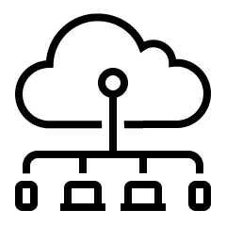
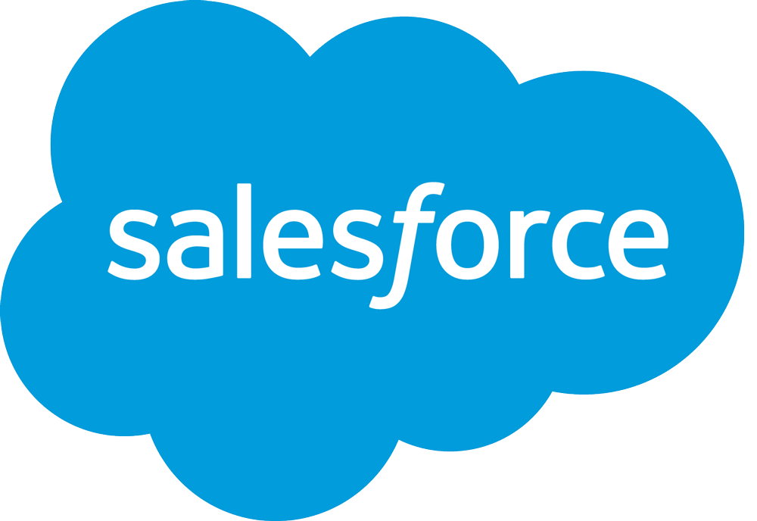
Notes:
In order to achieve low cost and fast introduction of security for services beyond the fortress, you need to have an all-in-one platform, without the need for anything else. In contrast to the multi-vendor fortress for your core services, where you need to configure and synchronize and test the security of the service in numerous systems, an all in one platform solves this problem, and accomplishes this in no time.
The all-in-one platform handles every aspect of security outside the fortress. From the device, through any infrastructure such as public networks, hotels and any other infrastructure that the user will chose to use, it is pre-integrated to the cloud services – so the platform already has done the heavy lifting for you, and you can just go and use it.
On the device itself, the platform should use a very minimal touch, respect users’ privacy, providing a seamless user experience, integrated into the normal use of the device. In parallel, the platform needs to be able to tell you when there is a risk to the fortress, such as in cases where the device is rooted, or not updated, or the internal security mechanism such as sandboxing of the OS is not working properly.
When it comes to the infrastructure, the security platform needs to be able to identify compromised infrastructure, malicious activity or attackers in the proximity of the users, and to automatically suggest to the user the best course of action – embedded into everyday use of the device. The platform needs to cover a wide range of hundreds of risks, and to do it without the need to install anything on the infrastructure or to use any hardware.
And in the third element, the services themselves, the platform needs to automatically enable the enterprise to introduce services, and to establish risk-based access policy, and even to remotely wipe accounts when applicable.
Having all-in-one platform that can handle security for services beyond the fortress is what enables enterprises to introduce services in minutes, at a fraction of the cost, and with no degradation in the user experience.

Slide 19
All in one SaaS security platform
Device
Network
Service
OS vendor
Connectivity provider
Cloud service provider
Anti-malware, OS exploits, App reputation
None
Internal service security
+
+
+
OS/Browser update
Rooting/Jailbreaking
Internal security operational verification
Connect user to safe network
Identify compromised network
Identify malicious activity in proximity
Identify attackers in legitimate network
Risk-based access policy
Remote account wipe
Service health check
Notes:
In order to achieve low cost and fast introduction of security for services beyond the fortress, you need to have an all-in-one platform, without the need for anything else. In contrast to the multi-vendor fortress for your core services, where you need to configure and synchronize and test the security of the service in numerous systems, an all in one platform solves this problem, and accomplishes this in no time.
The all-in-one platform handles every aspect of security outside the fortress. From the device, through any infrastructure such as public networks, hotels and any other infrastructure that the user will chose to use, it is pre-integrated to the cloud services – so the platform already has done the heavy lifting for you, and you can just go and use it.
On the device itself, the platform should use a very minimal touch, respect users’ privacy, providing a seamless user experience, integrated into the normal use of the device. In parallel, the platform needs to be able to tell you when there is a risk to the fortress, such as in cases where the device is rooted, or not updated, or the internal security mechanism such as sandboxing of the OS is not working properly.
When it comes to the infrastructure, the security platform needs to be able to identify compromised infrastructure, malicious activity or attackers in the proximity of the users, and to automatically suggest to the user the best course of action – embedded into everyday use of the device. The platform needs to cover a wide range of hundreds of risks, and to do it without the need to install anything on the infrastructure or to use any hardware.
And in the third element, the services themselves, the platform needs to automatically enable the enterprise to introduce services, and to establish risk-based access policy, and even to remotely wipe accounts when applicable.
Having all-in-one platform that can handle security for services beyond the fortress is what enables enterprises to introduce services in minutes, at a fraction of the cost, and with no degradation in the user experience.

Slide 20
ACCOMODATE ANY SCENARIO IN ONE PLATFORM
Services
When fortress cannot work
Any service
Users congregate
In the office
Out of office
VS.
Any device
Laptop
Desktop
Mobile
Laptop
Mobile
User
Any network
Out of office
In the office
Container #1
Container #2
Container #3
Fortress
Beyond the fortress
Notes:
In order to achieve low cost and fast introduction of security for services beyond the fortress, you need to have an all-in-one platform, without the need for anything else. In contrast to the multi-vendor fortress for your core services, where you need to configure and synchronize and test the security of the service in numerous systems, an all in one platform solves this problem, and accomplishes this in no time.
The all-in-one platform handles every aspect of security outside the fortress. From the device, through any infrastructure such as public networks, hotels and any other infrastructure that the user will chose to use, it is pre-integrated to the cloud services – so the platform already has done the heavy lifting for you, and you can just go and use it.
On the device itself, the platform should use a very minimal touch, respect users’ privacy, providing a seamless user experience, integrated into the normal use of the device. In parallel, the platform needs to be able to tell you when there is a risk to the fortress, such as in cases where the device is rooted, or not updated, or the internal security mechanism such as sandboxing of the OS is not working properly.
When it comes to the infrastructure, the security platform needs to be able to identify compromised infrastructure, malicious activity or attackers in the proximity of the users, and to automatically suggest to the user the best course of action – embedded into everyday use of the device. The platform needs to cover a wide range of hundreds of risks, and to do it without the need to install anything on the infrastructure or to use any hardware.
And in the third element, the services themselves, the platform needs to automatically enable the enterprise to introduce services, and to establish risk-based access policy, and even to remotely wipe accounts when applicable.
Having all-in-one platform that can handle security for services beyond the fortress is what enables enterprises to introduce services in minutes, at a fraction of the cost, and with no degradation in the user experience.

Slide 21
Fortress based security
Beyond the fortress security
INTEGRATION
DEPLOYMENT
EXPERIENCE
GOVERNANCE
SECURITY MODEL
Complex, multiple systems configuration
4-8 months for complete integration
Cumbersome. Containers, proxies…
Heavy
Restrictive
None: All-In-One system
Immediate. No integration
Native experience. No degradation at all
Minimal
Elastic
Notes:
The very foundation about security inside the Fortress has changed dramatically outside.
For example, the amount of services in use inside is dozens whereas outside it is hundreds. In fact, recent studies put the number at close to a thousand.
And life cycles of individual services can be be extremely short term
(for example, “I need to get a utility to analyze a dataset right now”) or (“our marketing team needs this design service for a project we are doing next week”).
Ultimately, the users are the approvers, not the enterprise, and they will not accept anything less than a superb experience.

Slide 22
Flexibility to adjust to any scenario, in order to minimize the restrictions to the user
ELASTIC SECURITY
Fortress
Block/Remove all apps
Offices/out of offices
Outside of the fortress
Users: all, management, travelers, at a location etc.
Locations: offices, airports, hotels, cities, countries, where users congregate, etc.
Intelligence: for any location
Actions: block/remove apps @container, control access to services, connect/disconnect from networks, alert the user, guide the user
Notes:
In order to achieve low cost and fast introduction of security for services beyond the fortress, you need to have an all-in-one platform, without the need for anything else. In contrast to the multi-vendor fortress for your core services, where you need to configure and synchronize and test the security of the service in numerous systems, an all in one platform solves this problem, and accomplishes this in no time.
The all-in-one platform handles every aspect of security outside the fortress. From the device, through any infrastructure such as public networks, hotels and any other infrastructure that the user will chose to use, it is pre-integrated to the cloud services – so the platform already has done the heavy lifting for you, and you can just go and use it.
On the device itself, the platform should use a very minimal touch, respect users’ privacy, providing a seamless user experience, integrated into the normal use of the device. In parallel, the platform needs to be able to tell you when there is a risk to the fortress, such as in cases where the device is rooted, or not updated, or the internal security mechanism such as sandboxing of the OS is not working properly.
When it comes to the infrastructure, the security platform needs to be able to identify compromised infrastructure, malicious activity or attackers in the proximity of the users, and to automatically suggest to the user the best course of action – embedded into everyday use of the device. The platform needs to cover a wide range of hundreds of risks, and to do it without the need to install anything on the infrastructure or to use any hardware.
And in the third element, the services themselves, the platform needs to automatically enable the enterprise to introduce services, and to establish risk-based access policy, and even to remotely wipe accounts when applicable.
Having all-in-one platform that can handle security for services beyond the fortress is what enables enterprises to introduce services in minutes, at a fraction of the cost, and with no degradation in the user experience.

Slide 23
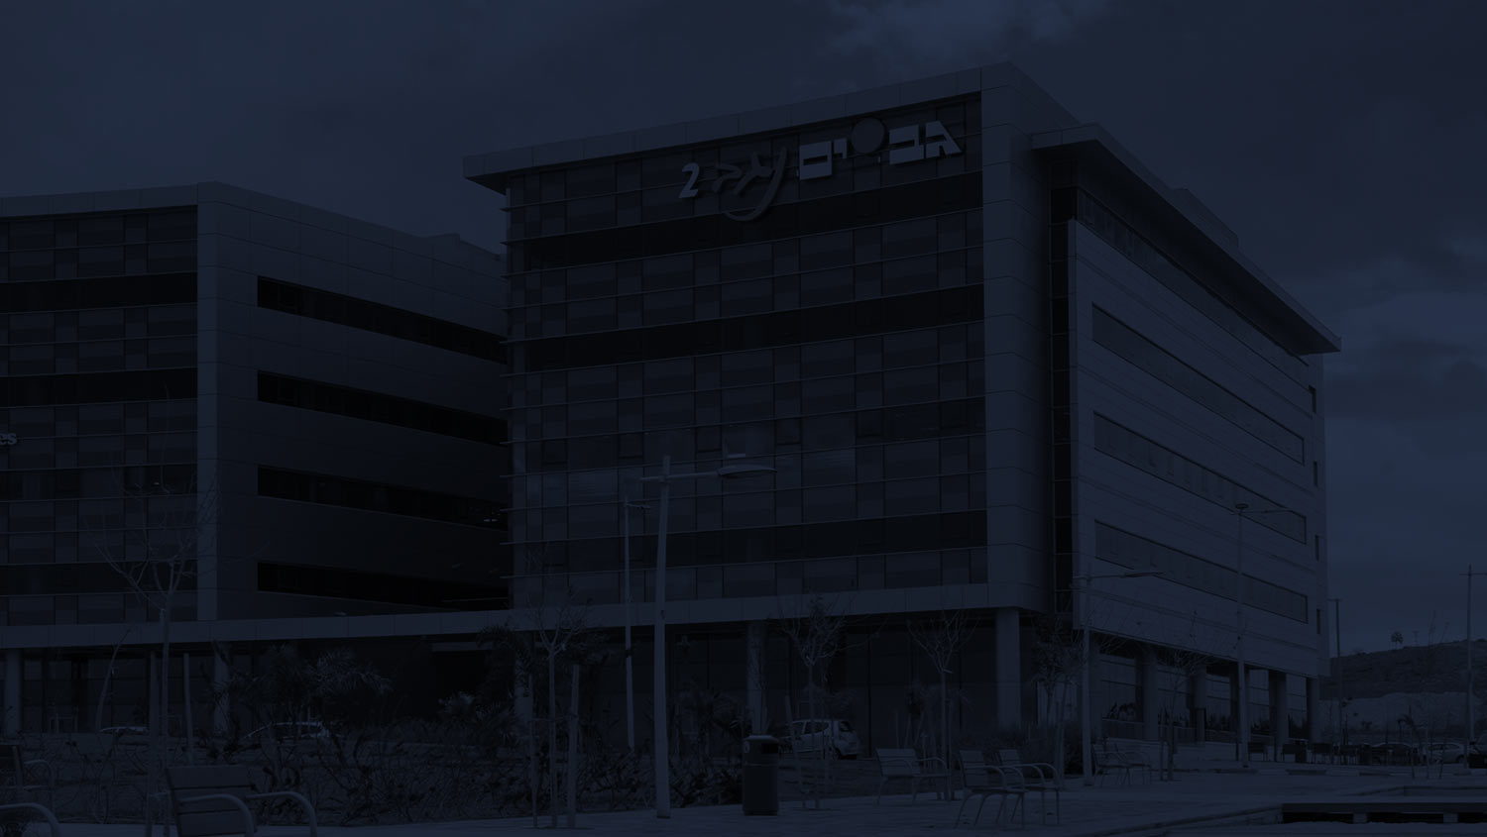
THIS IS WHY WE BUILT CORONET
Total Freedom
Rapid service Introduction
Zero Customization
Low Cost
End Users Satisfaction
Freedom to use any service,
work and connect from anywhere, on any platform
Minutes instead of months
No need for wrappers
or containers, Native use of any application or service
Fraction of the fortress cost
Security without degradation of user experience
Notes:
Up to now, we have described a world view. That world view is one that looks beyond the fortress and prescribes the requirements for a situationally flexible security solution.
We believe this is the world view, and this is what the security solution beyond the fortress should look like, and this is why we built Coronet.
To accommodate a diversity of work styles, recognizing the need for instant service availability, with no development runway, at minimal cost, and providing complete satisfaction to the end user.
So, beyond the fortress, Coronet provides an all-in-one security platform for the other 600 services that everybody is using.

Slide 24
Thank you!

